Slide 1

Welcome to the Magical Leaves Game
Your winnings in this game will earn you an additional payment bonus for participating in this study.
In any case you will still receive £6 per hour for completing this study.
However, you can earn up to an extra £0.5 based on your winnings in the game.

Slide 2
We will now provide instructions for the game. Please read them carefully.
You can go back and forth between screens as needed.

Slide 3
During the instructions, we will request that you complete a few brief quizzes,
to ensure everything is clearly understood.

Slide 4

In our village, there is a wizard who is willing to buy colored leaves that he needs for his magic.

Slide 5
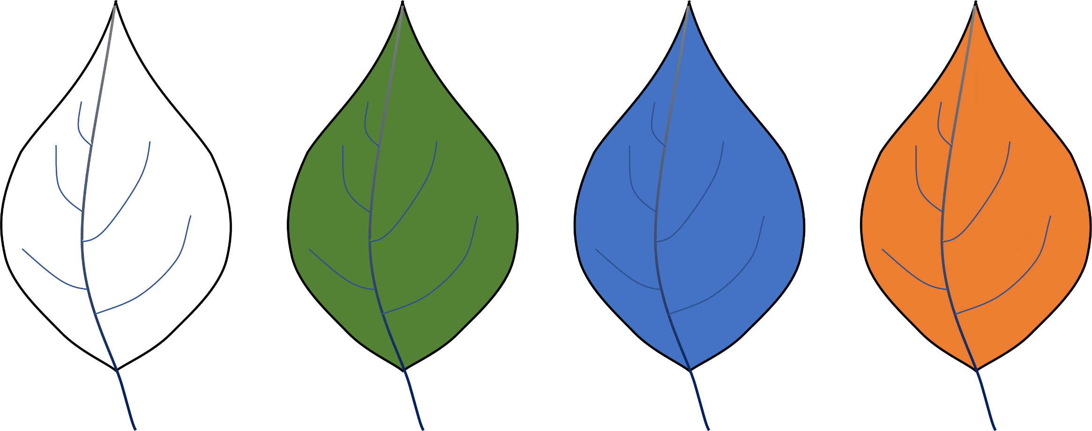
Below is an example of four leaves.

Slide 6

At each step in the game, two leaves fall from a magical tree.
You will only see the fallen leaves appearing on the screen, as illustrated below.
When the leaves fall, the wind will randomly cause one to drift to the left and the other to the right.
Your task is to choose one of the leaves to try and sell to the wizard.
If you want to choose the leaf on the left, press 'S' on your keyboard.
To choose the leaf on the right, press 'K'.

Slide 7
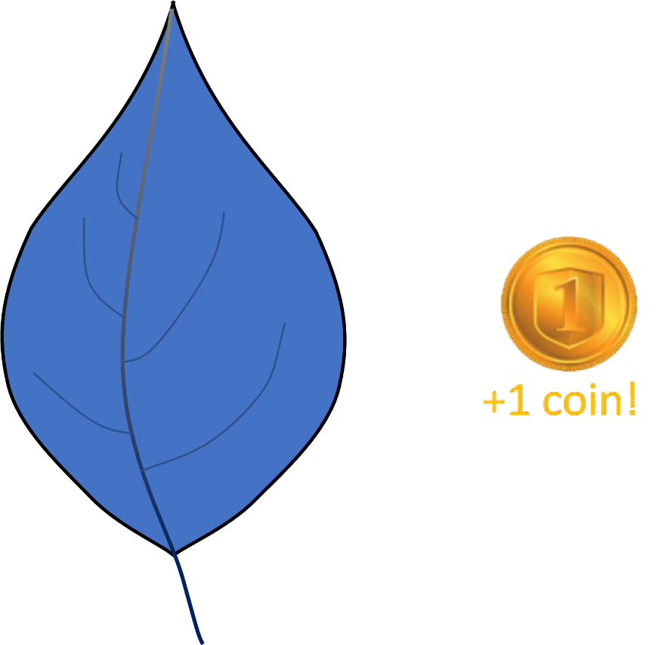
Once you've made your selection, you will see the selected leaf and whether the wizard decided to buy the leaf or not.
If the wizard chooses to buy the leaf, you will earn one golden coin.
The outcome will be displayed in the center of the screen, as shown below.

Slide 8
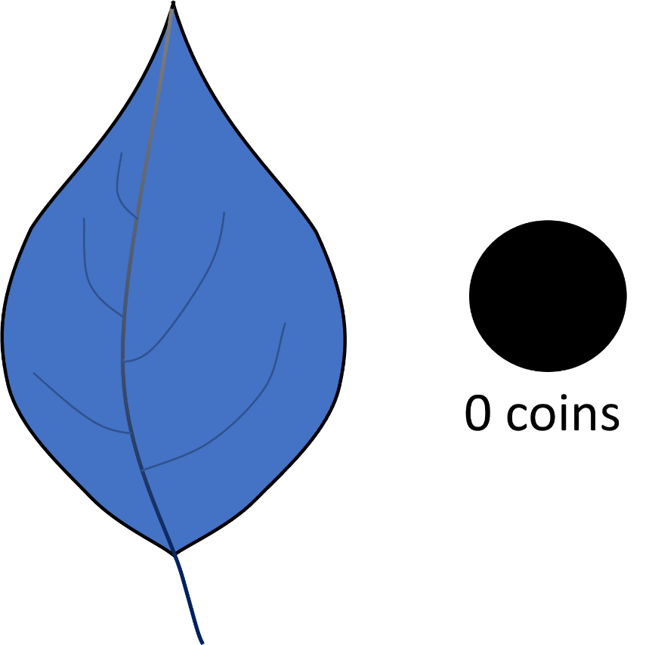
If the wizard chooses not to buy the leaf, you will earn nothing and a black coin will be displayed as in the picture below.

Slide 9
You will play 4 rounds of 50 choices each.
Every round will include 4 new leaves.
The golden coins you earn will be exchanged for a bonus reward at the end of the experiment – so this amounts to real money!

Slide 10
You will now take a brief quiz to make sure that you understand the instructions.
If you make a mistake, you will need to review the instructions again.
Press any key to continue.

Slide 11
Quiz – Understanding the Instructions
Q1. How many leaves in total are there in each round?
○ 2 ○ 4 ✓ ○ 6
Q2. How many fallen leaves will you be offered each time?
○ 2 ✓ ○ 4 ○ 6
Q3. How do you choose a leaf?
○ Click on it
○ Press the LEFT or RIGHT arrow keys
○ Press the S or K key with your LEFT or RIGHT hand ✓
Q4. What is the goal of the game?
○ The goal is to make the best selections and earn as much bonus money as I can ✓
○ The goal is to pick similar leaves

Slide 12
To help you succeed in the game as much as possible we will now provide some important clarifications.
Read them carefully, as we will quiz you about these clarifications to confirm your understanding.

Slide 13
1) The chance of winning a coin depends on the color of the leaf you choose.
At any given time, each colored leaf has a certain value for the wizard. The wizard doesn't always buy leaves.
If you choose a colored leaf that the wizard currently values highly, you have a higher chance to sell it to him.
If you choose a colored leaf that the wizard currently assigns little value to, you have a lower chance of selling it.
Therefore, you need to track the outcomes across time and do your best to learn the wizard's value for each leaf.
Your job is to make a leaf selection that will lead to the highest chance of gaining rewards, and obtain the highest amount of gold coins.

Slide 14
2) The value of the colored leaves slowly changes.
Throughout the game, the value of each colored leaf slowly changes – similar to how the demands of market products change.
So for example, if a certain color is highly valuable to the wizard at the start of the game, its value might still decrease/increase over time.
You need to keep sharp, track the outcomes you see when selecting colored leaves, and try your best to make selections that will maximize the number of golden coins earned.

Slide 15
3) Each colored leaf has its own value.
Each colored leaf has its own demand. Learning about one colored leaf tells you nothing about the other leaves.
For example, two, three, or even all four colored leaves may be highly valued by the wizard at a certain time.
The outcome you see after selecting a colored leaf is related only to the value of that specific colored leaf and means nothing regarding the value of the others.
Your task is to figure out the wizard's preferred leaves at any given time and select them.

Slide 16

4) The blowing wind is completely random.
After the colored leaves fall from the magical tree, the wind blows them to the left or to the right.
The wind is completely random. Therefore the location of the leaves (left or right) has no meaning to how high/low the wizard values a certain colored leaf.
Select only based on color.

Slide 17
You will now take a brief quiz to make sure that you understand the clarifications.
If you make a mistake, you will need to review the instructions again.
Please scroll down until you answer all the questions.
Press any key to continue.

Slide 18
Quiz – Understanding the Clarifications
Q1. The demand for a leaf can change during the round
○ True ✓ ○ False
Q2. If one leaf leads you to win more coins, it means the other leaves will probably lead you to win less coins
○ True ○ False ✓
Q3. Using the RIGHT response key instead of the LEFT key may increase your coin-winning chances
○ True – the response keys are related to coins winning chances
○ False – you won't win more or less using RIGHT ('k') or LEFT ('s'). Only the color of the leaves is related to your chances of winning coins. ✓
Q4. What determines the location of the leaves?
○ The wind ✓ ○ The Wizard ○ The leaves themselves ○ The demand for the leaves

Slide 19
Just before starting the game, let's test once again the clarity of our instructions using an illustrative example.

Slide 20
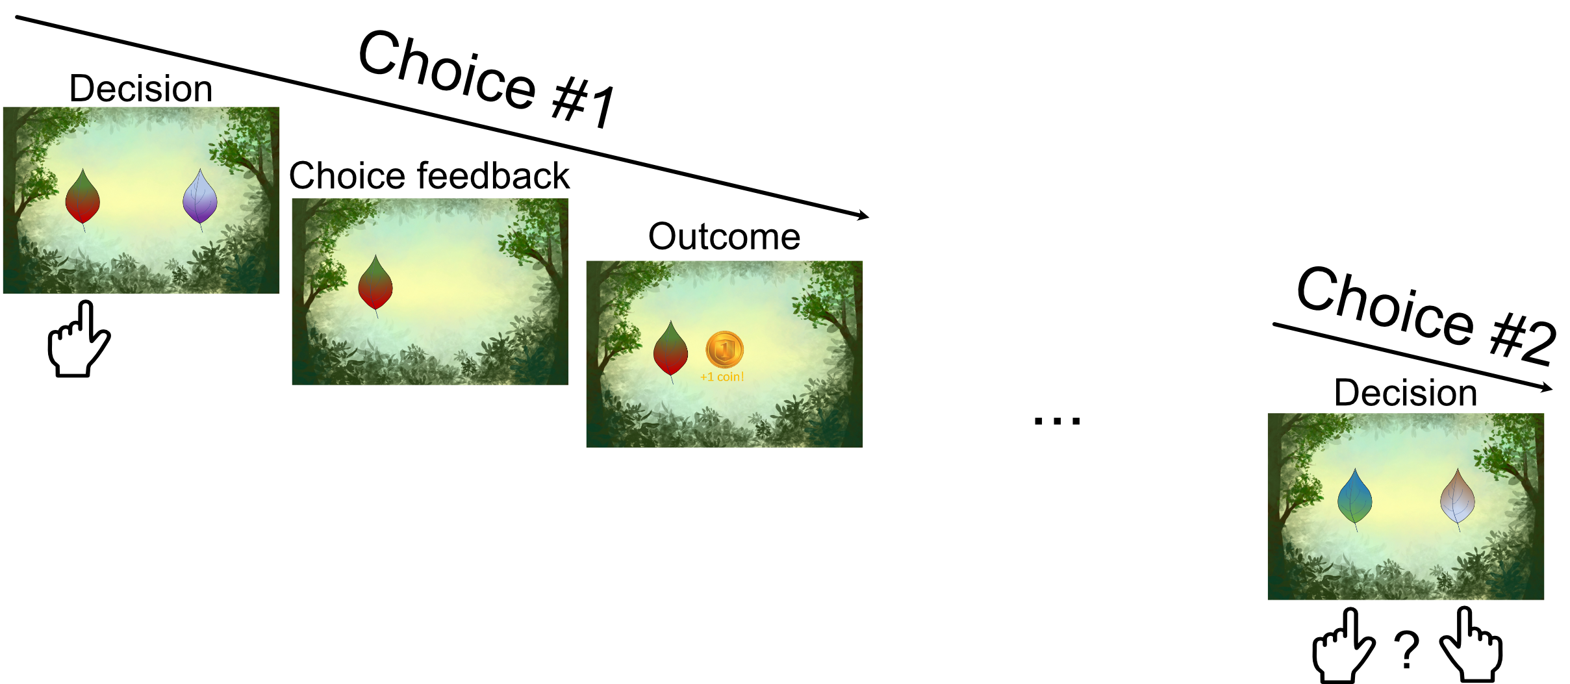
Q1. Here is an example for a participant that chose in choice #1 the reddish leaf appearing on the left, and got a reward.
What should be the preferred next choice when two new leaves are possible for selection?
○ I prefer the left leaf in choice #2
○ I prefer the right leaf in choice #2
○ I have no information about the two leaves offered in choice #2 so I have to guess ✓

Slide 21
Correct! Good job!
If you haven't seen these leaves before, please pick one at random.
Neither the leaf's placement nor the response key you selected affects your odds of winning a coin.
Let's do one more final question.

Slide 22

Q2. Here is an example for a participant that chose in choice #1 the reddish leaf appearing on the left, and got a reward.
In the next trial the choice was between a new leaf and one that was included in the previous trial.
What should be the preferred next choice?
○ I prefer the left leaf in choice #2
○ I prefer the right leaf in choice #2
○ I have no information about the two leaves offered in choice #2 so I have to guess ✓

Slide 23
Correct! Good job!
If you haven't selected these leaves before, please pick one at random.
What you learn about a certain leaf has nothing to do with the demand for the other leaves.

